Slide 1
Project Presentation of Back End Engineering Project (BEE) (22CS026)
On
URBAN CART
Joel Matthew(22109990465)
Kashish Barthwal(2210990495)
Karan Kumar Garg(22109904)
Kshitij Gulati(2210990525)
Kartavya Chaudhary(22109904)
Supervised By
Ms. Meenakshi
Mr. Shiv Mohan
Department of Computer Science and Engineering,
Chitkara University, Punjab

Slide 2
Introduction
Urban Cart is a comprehensive e-commerce platform designed to streamline both user and product management. It offers a complete solution for online retail businesses, providing robust backend functionalities for managing an extensive product catalog. With Urban Cart, products can be easily added and deleted through a custom API, ensuring efficient inventory control and flexibility to adapt to changing business needs.
The platform features secure login and signup capabilities, incorporating proper authentication to protect user data and maintain privacy. This ensures that only authenticated users can access the product database, enhancing security and providing a personalized shopping experience.
Urban Cart is built with React to deliver a dynamic and responsive user interface. The product database is displayed in a user-friendly manner, allowing customers to easily browse and search for items. The React-based frontend is designed to be intuitive and accessible, ensuring a smooth user experience across all devices.
Whether you are a small business looking to establish an online presence or a larger retailer needing a robust system to manage a vast inventory, Urban Cart offers a scalable and reliable solution. Its powerful features, combined with a focus on security and ease of use, make it an ideal choice for any e-commerce business aiming to deliver an exceptional online shopping experience.
2

Slide 3
Problem Statement
Inefficient Product Management: Many e-commerce platforms lack a robust backend system to efficiently manage product inventory, including adding, updating, and deleting products through a centralized API.
Security issues: There is a critical need for better security measures to protect user data and ensure that only authenticated users can access sensitive information, such as the product database.
Poor User Experience: The absence of a dynamic and responsive frontend interface can lead to a subpar user experience, making it challenging for customers to navigate the site and find products easily.
Urban cart is ideal for both small businesses and large retailers, providing a scalable and reliable solution.

Slide 4
Technical Details
1. Backend Functionality
API Development:
Custom API: Developed using Node.js and Express.js.
Endpoints:
Product Management: APIs for adding, deleting, and retrieving products.
User Management: APIs for user signup, login, and authentication.
Data Storage:
Database: JSON file for storing product and user data (could be replaced with a more robust database like MongoDB or SQL in a production environment).
CRUD Operations: Handling of product data through API endpoints.
Authentication:
Security: Implementation of authentication mechanisms using user’s email and password.
User Management: Secure handling of user credentials and session management.

Slide 5
2. Frontend Functionality
React.js:
User Interface: Built with React for a dynamic and responsive user experience.
Components:
Product Display: Components to render product data fetched from the backend.
Login/Signup Forms: Components to handle user authentication.
Admin Interface: Interfaces for managing product data (if applicable).
Routing:
React Router: Used for handling navigation between different pages (e.g., login, signup, product listings).
Data Handling:
Fetching Data: Using fetch or axios to retrieve data from backend APIs.
State Management: Managing state with React’s useState and useEffect hooks

Slide 6
Key Features
1. Secure Login and Signup:
User Authentication: Allows users to create accounts and log in securely.
Password Encryption: Ensures user passwords are stored securely using encryption methods.
Session Management: Manages user sessions to maintain secure access.
2. Authentication and Authorization:
User’s email and password based Authentication: Authentication is based on user’s email and password.
Access Control: Restricts access to certain features and data to authenticated users only.
3. Dynamic Card Display:
Product Presentation: Uses React components to dynamically display product information in a user-friendly card format.
Responsive Design: Ensures that product cards are displayed correctly across different devices and screen sizes.
These features ensure that Urban Cart provides a secure, user-friendly, and efficient e-commerce experience.

Slide 7
Project Highlights
1. Comprehensive E-Commerce Solution:
End-to-End Functionality: A complete platform that integrates product management, user authentication, and dynamic content display.
Secure Authentication:
Login/Signup: Robust authentication system for secure user registration and login.
Password Encryption: Advanced encryption techniques for secure storage of user credentials.
2. Dynamic Product Management:
Custom API: A dedicated API for handling product-related operations (CRUD - Create, Read, Update, Delete).
3. User-Centric Design:
Dynamic Card Display: Interactive and visually appealing presentation of products using React components.
Responsive Layout: Optimized for a seamless shopping experience across all devices and screen sizes.

Slide 8
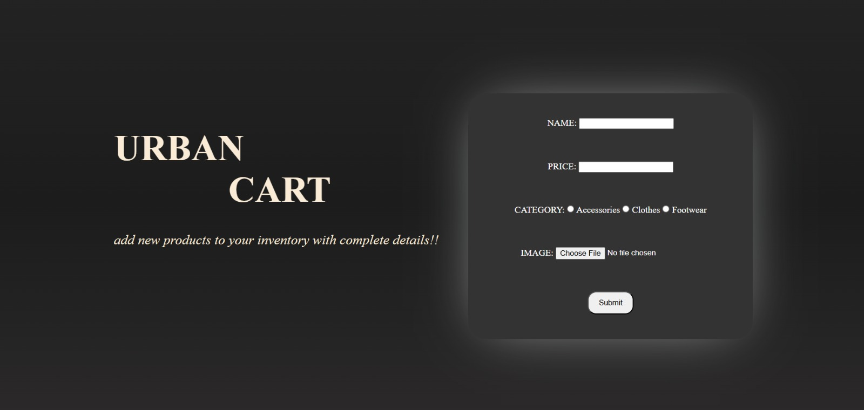
Output Of The Code

Slide 9
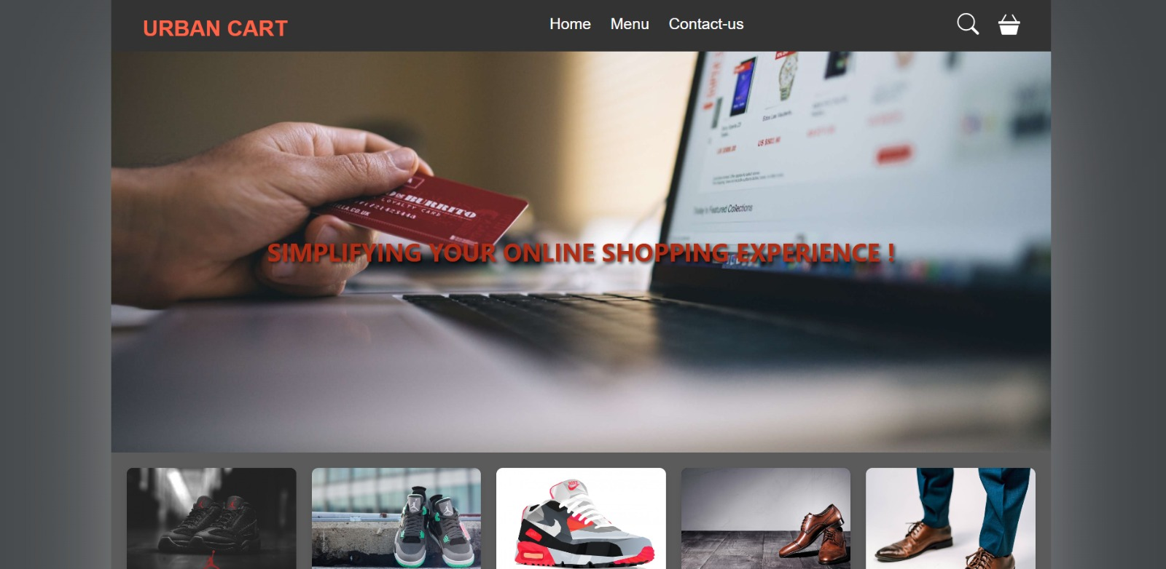

Slide 10
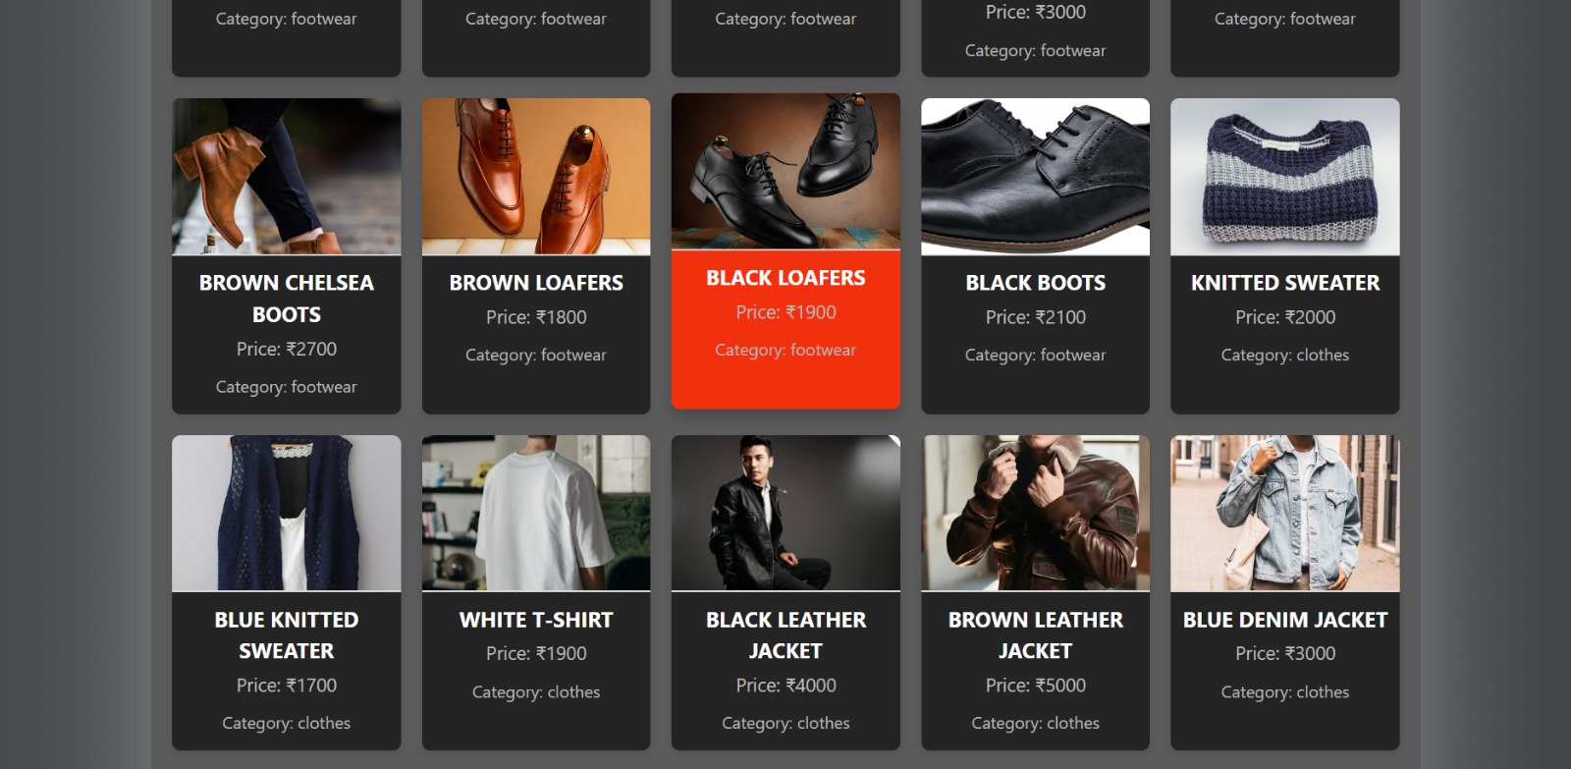

Slide 11
Conclusion
Urban Cart is a user-friendly e-commerce platform that simplifies online shopping and product management. It allows users to securely sign up, log in, and browse products. The platform features a custom API that makes it easy to add or remove products from the inventory.
With its modern React-based interface, Urban Cart presents products in a dynamic and visually appealing way. Only logged-in users can access the product database, ensuring a secure and personalized experience.
Overall, Urban Cart combines ease of use, strong security, and effective product management to provide a seamless online shopping experience for both businesses and customers.

Slide 12
References
https://www.geeksforgeeks.org/nodejs/
https://www.myntra.com/
https://mockaroo.com/projects
https://react-shop-siza.vercel.app/products
https://www.codingnepalweb.com/free-login-registration-form-html-css/

Slide 13
Thank You
13

